Slide 1

HCL Cache

Slide 2
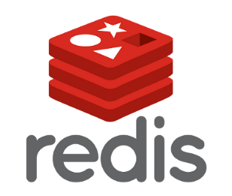
HCL Cache
+9.1 caching framework with local and remote caching capabilities
Implemented as DynaCache Cache Provider to work with existing code
Remote caching (with Redis) improves scalability and performance:
Pods can be scaled while minimizing added DB workload
Pods have immediate access to cache – short/no warmup time
System is more resilient to cache clear operations
2-tier cache system keeps the most accessed cache entries local to the JVM, eliminating remote I/O, and freeing up Redis resources
Local cache invalidation is handled within the Cache Provider with Redis PUB/SUB feature
Kafka is no longer required but still supported for legacy configurations
New HCL Search (based on Elastic) requires Redis for messaging bus

Slide 3
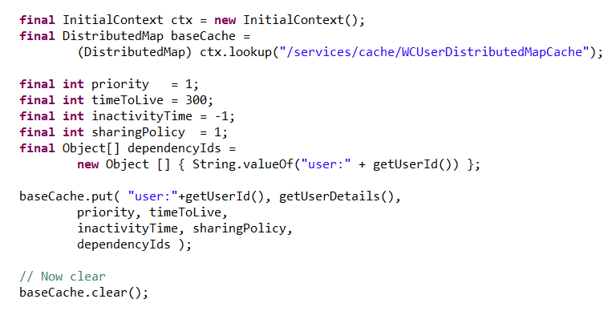
HCL Cache Architecture
HCL Cache Provider
HCL Cache Local Caching
HCL Cache Flexible Configurations:
Local and Remote (default)
Local Only
Remote Only
No Caching (used as messaging bus only)
HCL Cache is implemented as a DynaCache Cache Provider, enabling all existing code that uses DynaCache interfaces to continue working without change
* HCL Local Cache is in-memory only Disk Offload is not supported

Slide 4
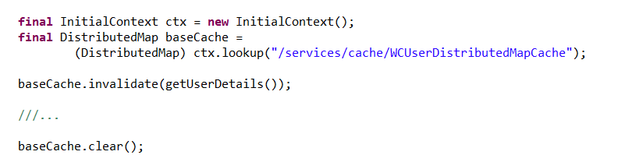
HCL Cache Architecture - Invalidations
HCL Cache Provider
HCL Cache Local Caching
Invalidations on local caches are replicated
The invalidation process is handled within the Cache Provider (like DRS)
Invalidations are replicated to other pods using PUBSUB channels
HCL Cache Provider
HCL Cache Local Caching
HCL Cache Provider
HCL Cache Local Caching
HCL Cache Provider
HCL Cache Local Caching

Slide 5
Remote HCL Caches in Redis
Redis should be configured with maxmemory and volatile-lru
The standard Redis topologies are supported:
Single, Master+Slave, Sentinel, Cluster with replicas
Redisson client is used. The Connection details are customizable
Caches are mapped to a single cache slot {cache-demoqa-services/cache/WCSearchDistributedMapCache}-
Enables atomic operations
Caches are operated with LUA scripting and pipelining
Cache entries have expiry set ( can be evicted / LRU). Metadata (dependency ids) are maintained by the HCL Cache

Slide 6
Redis Scalability and High Availability Features
Scalability:
Can configure N number of Redis nodes
Ability to decide which nodes run which caches
High Availability:
Redis:
Using Slaves/Replicas
Persistence
HCL Cache Circuit Breaker (Client side)
If Redis is detected down, HCL Cache temporarily switches to local-only mode with short timeouts (configurable)
Supports cluster-require-full-coverage setting: Only caches on affected nodes are marked down

Slide 7




Redis Deployment Options
Redis as a service (cloud only)
All popular cloud vendors offer a version of managed Redis
Options vary by vendor. (e.g. some vendors don’t yet support Redis clustering)
RedisLabs offers a managed version of Redis Enterprise thru the cloud vendors marketplace
Redis open source (download / cloud or on-prem)
Installed within the Kubernetes cluster, or in a separate VM/bare metal
Allow for full control of tuning options
Enterprise Redis from RedisLabs
On-prem or cloud (managed versions)
Extends the open source version and provides improved features for high availability and cluster management
Google Memorystore
ElastiCache
Azure Cache for Redis
Redis Enterprise

Slide 8
Redis Deployment - Support
HCL provides function-based support for the HCL Cache
Performance tuning recommendations are best-effort
Redis server support
Open source (downloadable) versions
Community support
Best-effort HCL Support:
HCL will validate that the HCL Cache use of Redis is correct
Might recommend configuration changes or upgrades
Redis as a service (Cloud)
Cloud providers are responsible for Redis support and HA
Redis Enterprise
Paid Redis version that includes support
Managed and downloadable versions (can run inside Kubernetes)
Besides support, Redis Enterprise provides enhanced sharding (clustering) and high availability features
Google Memorystore
ElastiCache
Azure Cache for Redis
Redis Enterprise

Slide 9
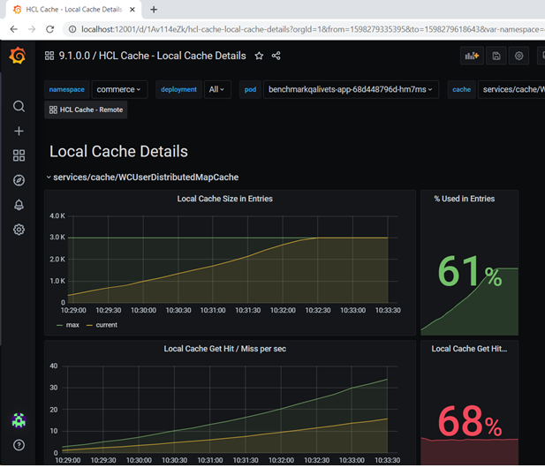
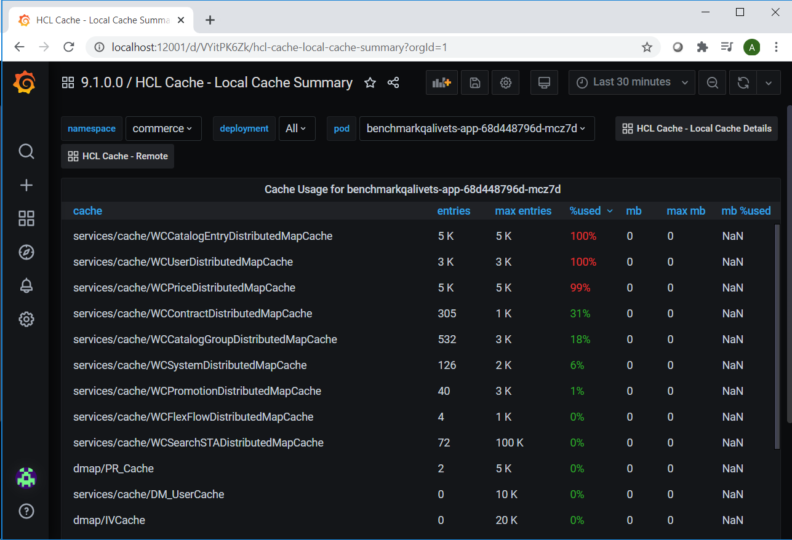
Manageability and monitoring - Prometheus/Grafana
HCL Cache implements the new 9.1 monitoring framework with Micrometer

Slide 10
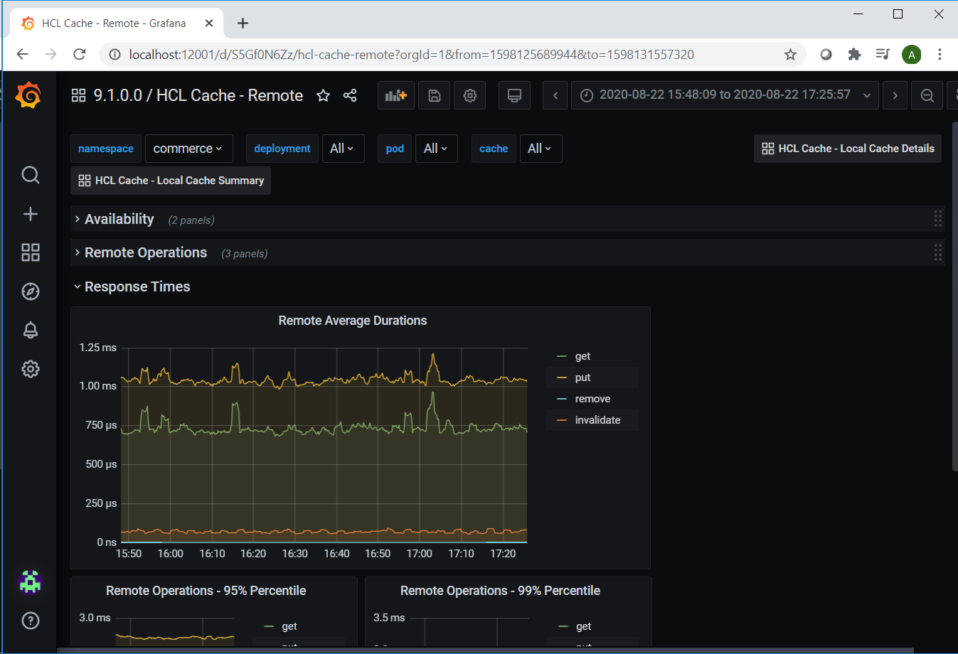
Manageability and monitoring – Prometheus/Grafana

Slide 11
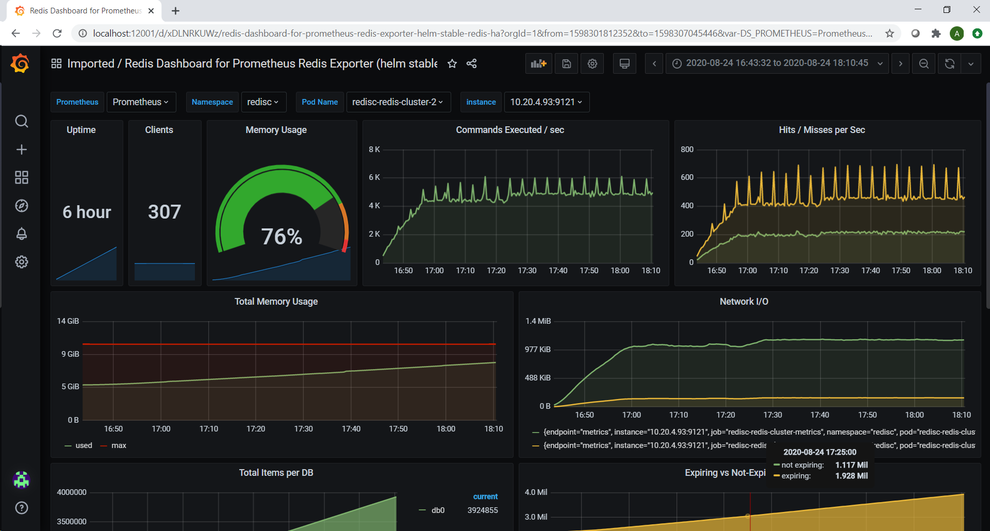
Redis Monitoring – Prometheus/Grafana

Slide 12
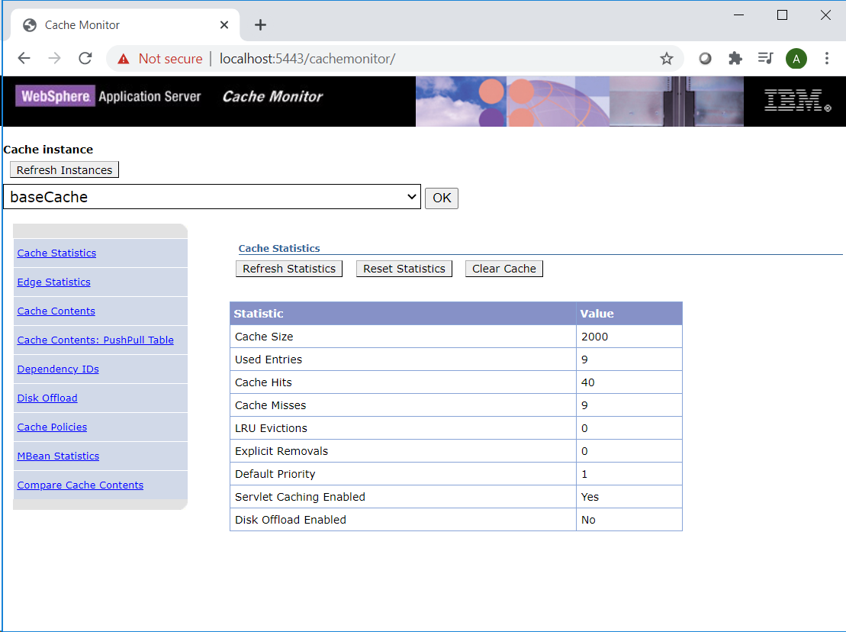
Manageability and monitoring – DynaCache Cache Monitor
Only the local cache portion of the HCL Cache is displayed in the Cache Monitor
Invalidation operations (including clears) are propagated to the remote cache
In Kubernetes environments, the Cache Monitor for each pod can be accessed with a port-forward rule kubectl port-forward -n commerce demoqalivets-app-5969f45c5-cnvfs 5443:5443

